Slide 1




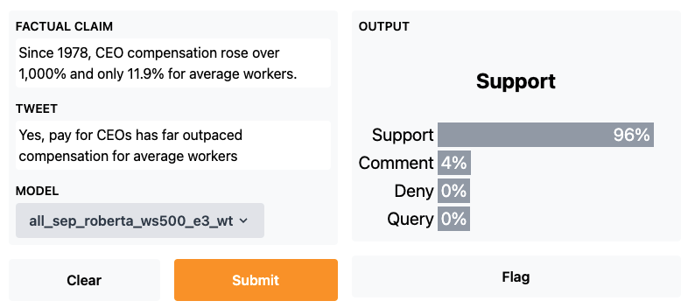





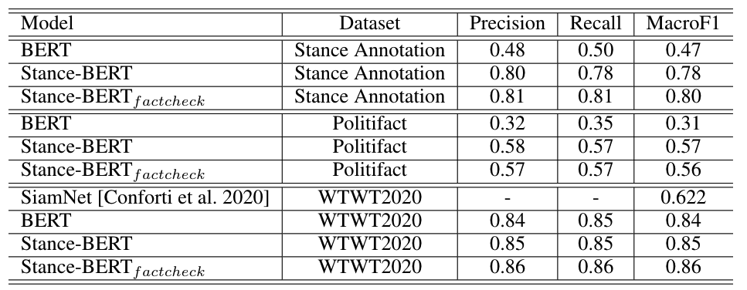
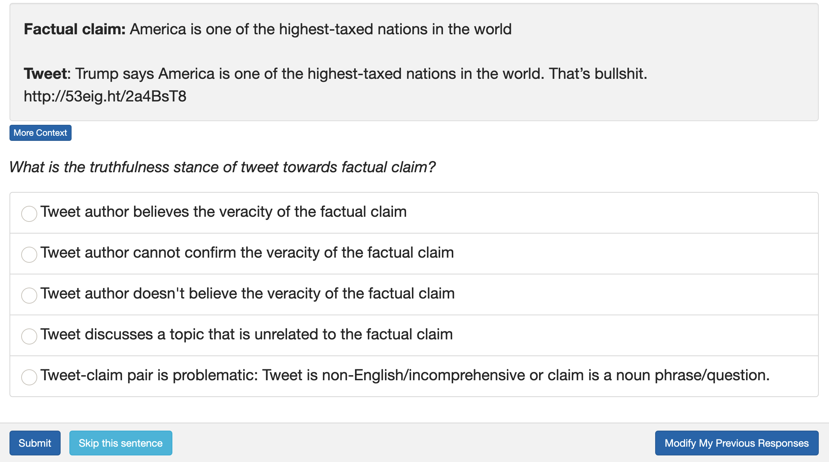
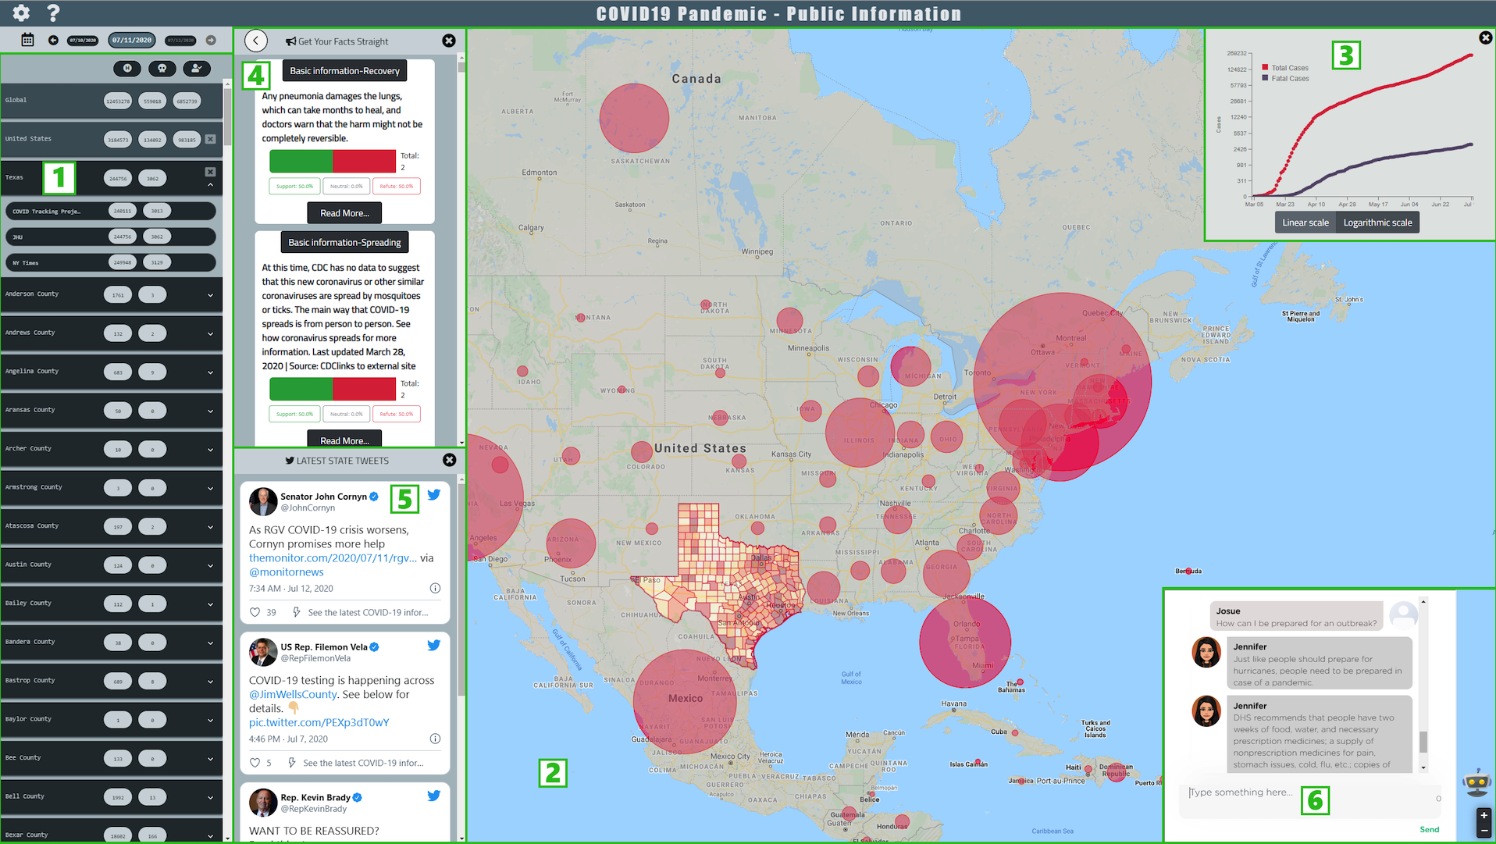
On Mitigating Misinformation by Stance Detection
Student Computing Research Festival (SCRF) 2022
Zhengyuan Zhu Zeyu Zhang Foram Pankajbhai Patel Josue Caraballo
Advisor: Chengkai Li
Innovative Data Intelligence Research Laboratory
Annotation System: idir.uta.edu/wildfire_annotation/ Stance Detection API Interface: idir.uta.edu/stance_detection Covid-19 Dashboard: idir.uta.edu/covid-19
The Quest to Mitigate the Misinfodemic by Stance Detection
Social media posts make false claims
Misinformation exacerbates the vicious impact
How stance detection mitigates misinfodemic
“The COVID-19 vaccine is the deadliest vaccine ever made”
“A viral photo shows the freedom convoy in Canberra, Australia, with over 1.5 million”
“CNN confirms Trump WILL be ARRESTED”
Drown out credible information
Interfere with measures to contain the outbreak
Deplete resources and overloads the health care system
Stance is whether a tweet supports or refutes a factual claim
Use stance detection for surveillance of misinfodemic and for discovering patterns of misinformation spreading
The Methodology of Stance Detection on Tweet-claim Pairs
Fact Check Collection
Pretrained
Language
Model
Stance Detection Classifier
Stance Detection API Interface
Factual Claims
Twitter API
Tweet-Claim Pairs
Data Collection: Factual Claims, Tweets and Stance Dataset
Performance of Stance Detection
Factual claims
Tweets
Built a daily fact check collection tool
52,805 factual claims from seven fact-checking websites
Used claim keywords and twitter academic research API to collect tweets.
65,011 distinct claim related tweets from 2007 to 2022
Stance detection annotation system
Case Study: COVID-19 Dashboard
Stance detection model trained using tweet-claim pairs annotated by human annotators
Components: 1) Geographic region selection panel. 2) Interactive map. 3) Timeline chart. 4) Panel of facts. 5) Government tweets. 6) Chatbot.

